Slide 1
Sampling
Applied Statistics

Slide 2
Introduction
Inductive statistics / Statistical inference
• Population: arrangement of objects under study in any statistical investigation
• Types of Population: Existential and Hypothetical

Slide 3
Existential Population
Population consists of concrete objects Known as Existential Population
Types:
Finite Population
Infinite Population

Slide 4
Hypothetical Population
Population does not consist of concrete objects Known as Hypothetical Population
Consists of imaginary objects

Slide 5
Sampling
A finite subset of population selected for investigation
The objective: to study properties
No. of units in sample = Sample Size

Slide 6
Parameters & Statistics
Population Parameters: Mean (μ), Variance (σ²), Skewness (β₁), Kurtosis (β₂)
Sample Statistics: Mean (x̄), Variance (s²), Skewness (B₁), Kurtosis (B₂)

Slide 7
Estimation
t = t(x₁, x₂, …, xn) is an unbiased estimate if:
E(t) = θ or E(statistics) = parameter
Example:
- E(x̄) = μ
- E(s²) = σ²

Slide 8
Sampling Distribution
Definition: Distribution of values of a statistic obtained from all possible samples of the same size.
If N = size of population, n = sample size:
Number of possible samples = (N_c_n) = N! / [n!(N-n)!]
Example: Sample means distribution.
Properties:
- Mean of sampling distribution = μ
- Variance of sampling distribution = σ² / n

Slide 9
Standard Error in Sampling Distribution
Formula:
SE = √[ Σ (t − t̄)² / n ]
Where t = sample statistic
Applications:
- Hypothesis testing
- Construction of confidence intervals

Slide 10
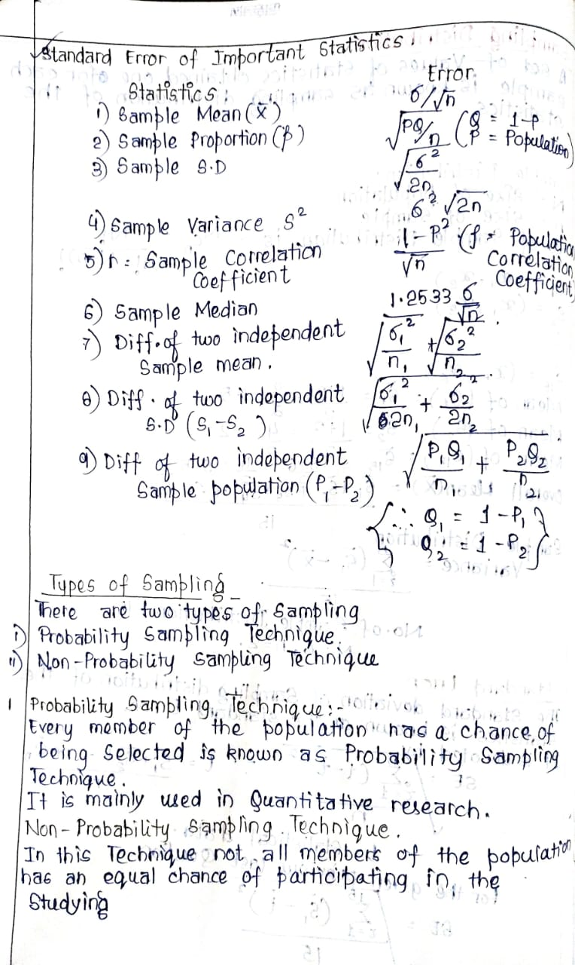

Slide 11
Types of Sampling
Two Main Types:
1. Probability Sampling
Every member of the population has a known, non-zero chance of being selected.
2. Non-Probability Sampling
Some members have no chance of selection.
Selection depends on the researcher’s choice.

Slide 12
Probability Sampling Techniques
1. Simple Random Sampling
Each member has an equal chance of selection.
Example: Lottery method.
2. Stratified Sampling
Population is divided into homogeneous groups (strata).
Random samples taken from each stratum.
3. Systematic Sampling
Every k-th element is chosen after a random start.
Sampling Interval: K = N / n.
4. Cluster Sampling
Population divided into clusters.
Some clusters chosen randomly.
All members in selected clusters are studied.

Slide 13
Non-Probability Sampling Techniques
1. Convenience Sampling
Selecting the most accessible population members.
2. Judgment Sampling
Researcher selects members based on expertise or judgment.
3. Quota Sampling
Data collected from groups to fill a fixed quota.
4. Snowball Sampling
Existing participants recruit further participants.

Slide 14
Theory of Estimation
• Purpose:
Estimation of population parameters (mean, variance, proportion, etc.) using statistics from samples.
Types of Estimation:
Point Estimation
A single value used as an estimate of the parameter.
Interval Estimation
A range of values within which the parameter is expected to lie.

Slide 15
Point Estimation: A single numerical value calculated from sample data that serves as the best estimate of a population parameter.
Example:
To estimate the population mean (μ), we may use the sample mean (x̄).

Slide 16
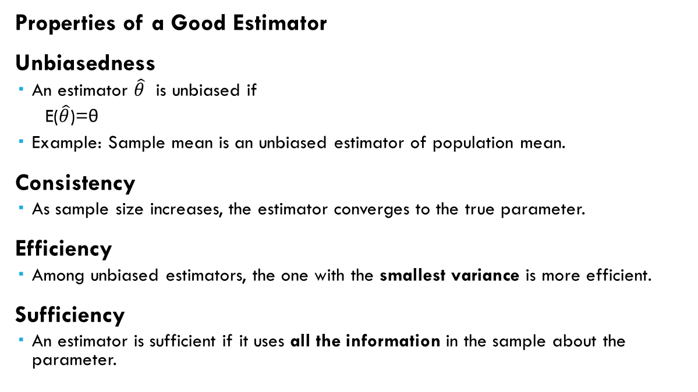
Properties of a Good Estimator
Unbiasedness
  An estimator $\hat{θ}$ is unbiased if
  E($\hat{θ}$)=θ
  Example: Sample mean is an unbiased estimator of population mean.
Consistency
  As sample size increases, the estimator converges to the true parameter.
Efficiency
  Among unbiased estimators, the one with the smallest variance is more efficient.
Sufficiency
  An estimator is sufficient if it uses all the information in the sample about the parameter.

Slide 17
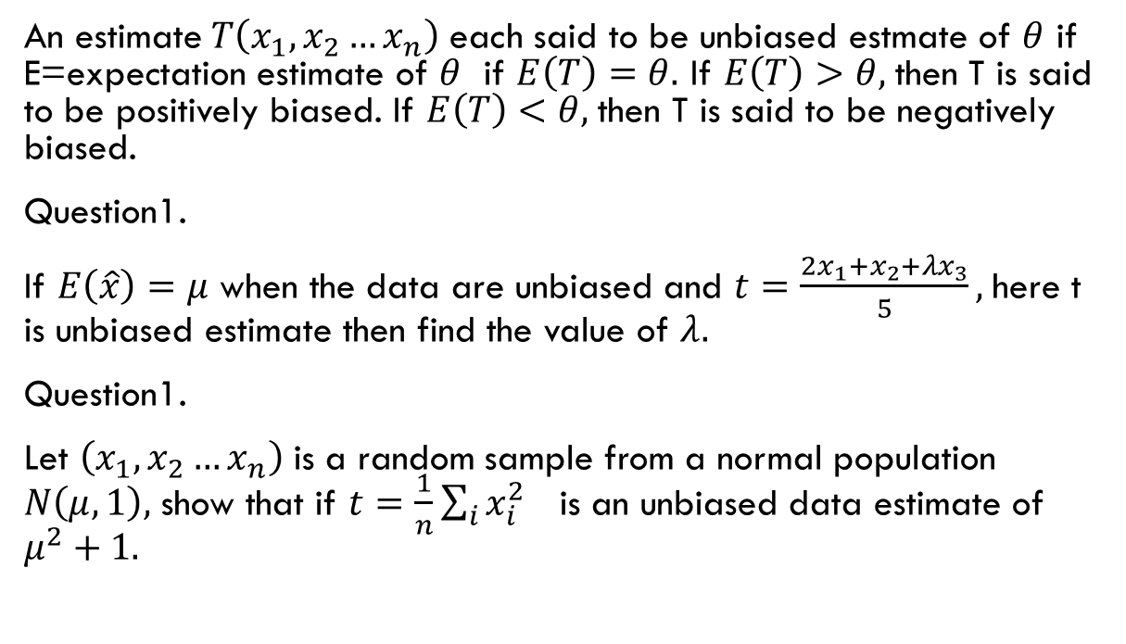
Unbiasedness
An estimate$T\left(x_{1},x_{2}…x_{n}\right)$ each said to be unbiased estmate of $θ$ if E=expectation estimate of $θ$ if $E\left(T\right)=θ.$ If $E\left(T\right)>θ,$then T is said to be positively biased. If $E\left(T\right)<θ,$then T is said to be negatively biased.
Question1.
If $E\left(\hat{x}\right)=μ$ when the data are unbiased and $t=\frac{2x_{1}+x_{2}+λx_{3}}{5},$here t is unbiased estimate then find the value of $λ.$
Question1.
Let $\left(x_{1},x_{2}…x_{n}\right)$ is a random sample from a normal population $N\left(μ,1\right),$ show that if $t=\frac{1}{n}\sum_{i}{x_{i}^{2} }$is an unbiased data estimate of $μ^{2}+1.$

Slide 18
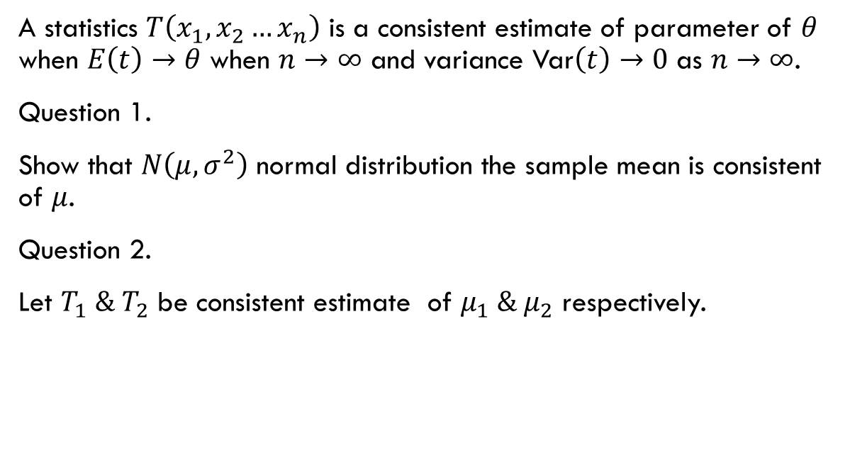
Consistency
A statistics $T\left(x_{1},x_{2}…x_{n}\right)$ is a consistent estimate of parameter of $θ$ when $E\left(t\right)→θ$ when $n$ $→∞$ and variance Var$\left(t\right)→0$ as $n$ $→∞$.
Question 1.
Show that $N\left(μ,σ^{2}\right)$ normal distribution the sample mean is consistent of $μ$.
Question 2.
Let $T_{1} \& T_{2}$ be consistent estimate of $μ_{1} \& μ_{2}$ respectively.

Slide 19
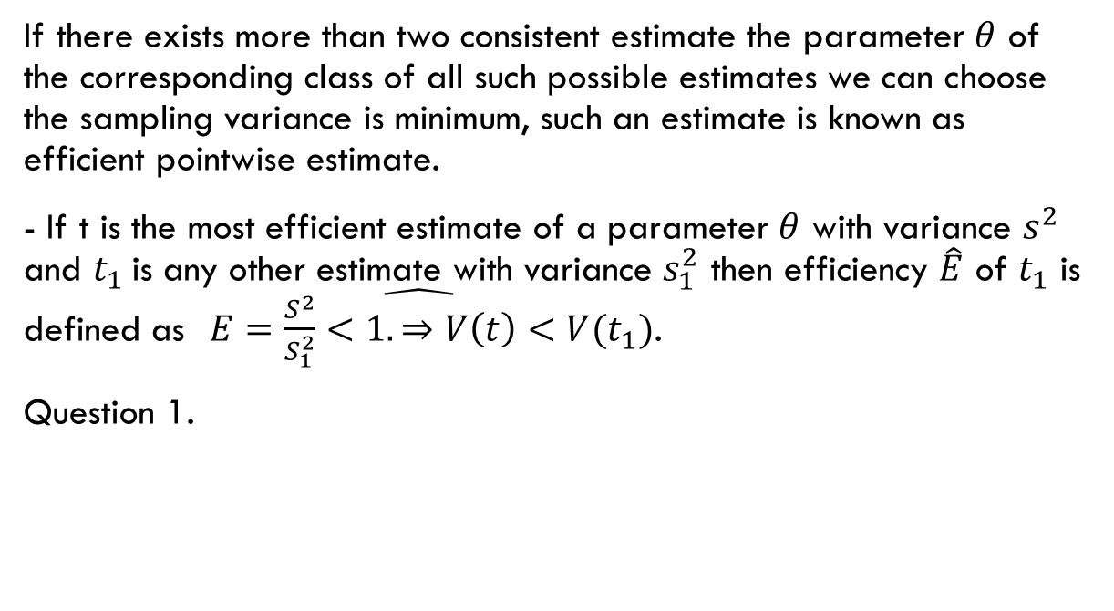
Efficiency
If there exists more than two consistent estimate the parameter $θ$ of the corresponding class of all such possible estimates we can choose the sampling variance is minimum, such an estimate is known as efficient pointwise estimate.
- If t is the most efficient estimate of a parameter $θ$ with variance $s^{2}$ and $t_{1}$is any other estimate with variance $s_{1}^{2}$ then efficiency $\hat{E}$ of $t_{1}$ is defined as$\hat{ E=\frac{S^{2}}{S_{1}^{2}}<1.⇒V\left(t\right)<V(t_{1})}$.
Question 1.

